Slide 1
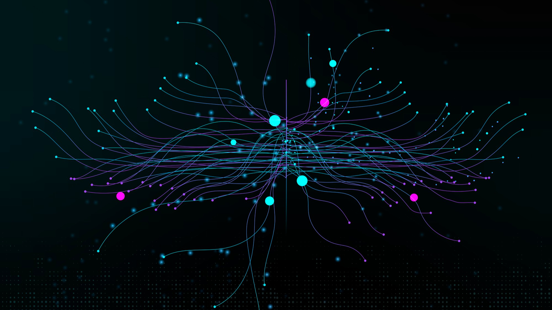
Deep Learning: Image Classification with CNN
PROJECT WEEK 6
BY DUSAN DOKIC
KEREM SENLER
& JULIA NUSS

Slide 2
PROJECT OVERVIEW
GOAL
Training a model that can classify images into 10 different classes
Evaluating its accuracy by different metrics as well as on pre-trained models
Deploying an app that allows users to upload images to classify them
KEY LEARNING OBJECTIVES
Learning how to build a CNN model for image classification with the highest accuracy possible
Finding out what options you have for image augementation or which hyperparameters you could use to refine the model
Evaluating by using pre-trained models
Learning how to deploy the model by creating an app

Slide 3
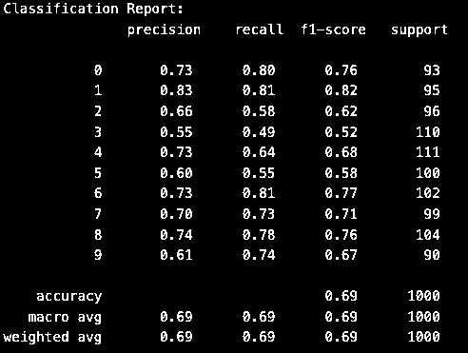
IMPLEMENTATION DETAILS
STEPS TAKEN
IMAGE PREPROCESSING
Trying out different ways to preprocess the images such as normalization, RandomHorizontalFlip, RandomCrop, Gamma correction, Gaussian blur/noise to see which one performs best using a simple model on a randomized batch of 20% of the dataset
MODEL ARCHITECTURE
Trying out different hyperparameters, different ways of pooling (Attention-based pooling, Learnable pooling with Capsule Networks,…) and activation (Relu, Elu, Selu, Swish, Mish…)
Refining the model (e.g. Early Stopping)
THE INITIAL MODEL:

Slide 4
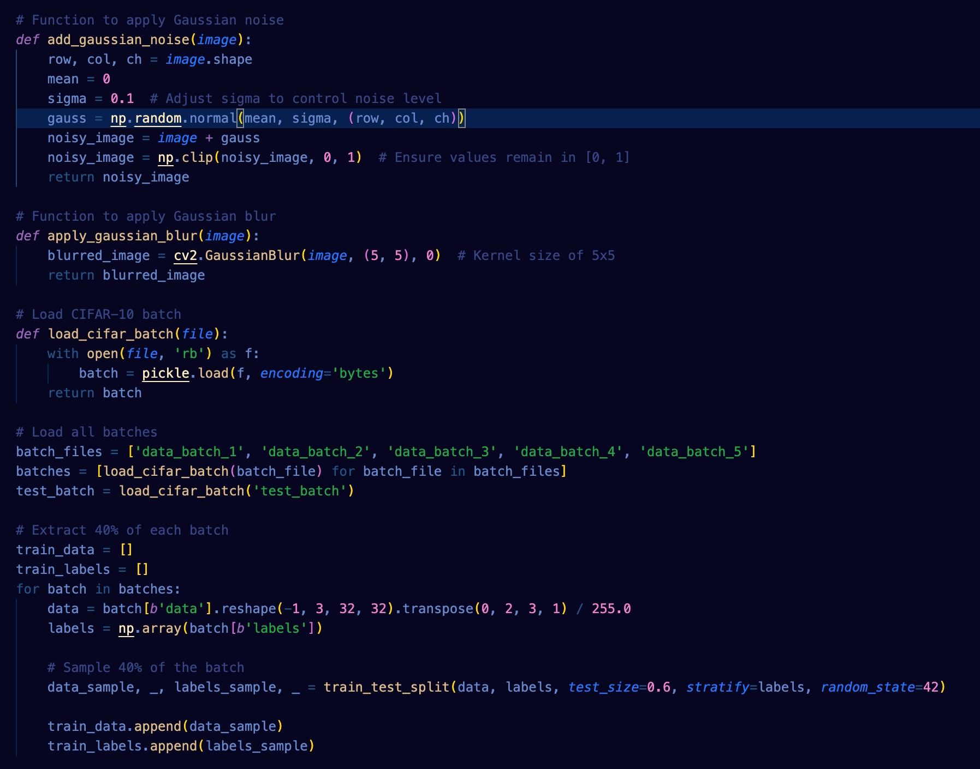
FIRST MODEL: LOADING A BATCH OF 40 % OF THE DATASET & AUGMENTATION

Slide 5
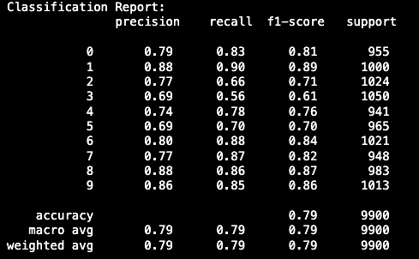
IMPLEMENTATION DETAILS
STEPS TAKEN
MODEL EVALUATION
Evaluating the model by through the precision, recall and f1-score
TRANSFER LEARNING
Using different pre-trained models: VGG16, Inception, ResNet, AGG15
Best result reached with: Inception
THE FINAL MODEL:

Slide 6
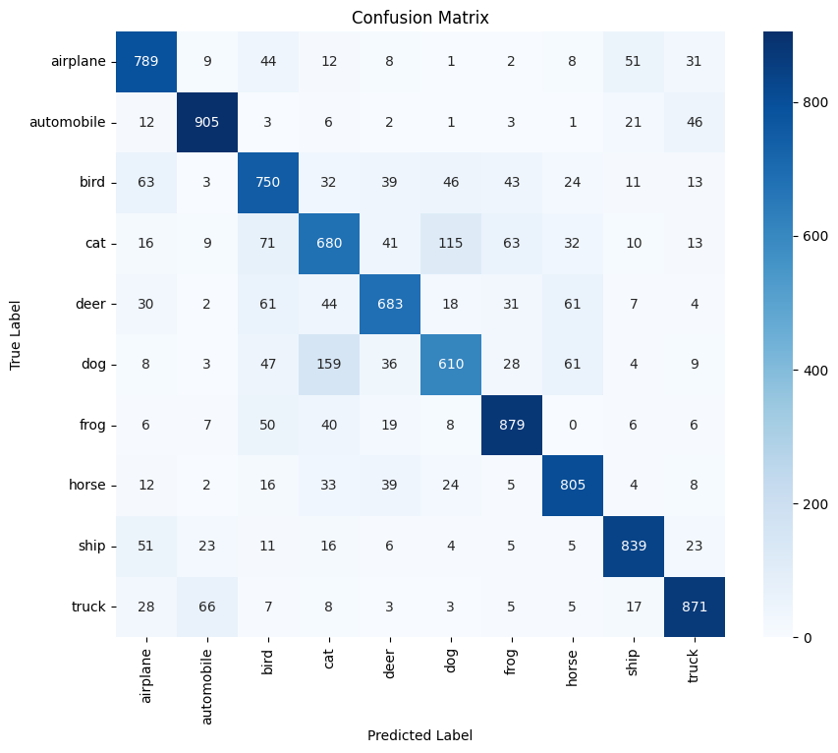

Slide 7
IMPLEMENTATION DETAILS
MODEL DEPLOYMENT – FLASK APP
Set up a Flask Application
Initialized a basic Flask application.
Set up two routes:
/: A homepage where users can upload images.
/predict: A route that processes the uploaded image, feeds it to the pre-trained model, and returns the prediction results.
Used the Pillow library to handle image processing (resizing and converting to RGB).
Used TensorFlow to load the pre-trained model and make predictions.
Set Up Templates and Static Files:
Files Created:
templates/upload.html
templates/result.html
static/css/style.css

Slide 8
IMPLEMENTATION DETAILS
Installed Required Packages:
Tested the Flask Application Locally
Set Up and used ngrok:
Installation and authentification
Exposed the local Flask app to the internet using ngrok, which provided a public URL (e.g., http://xyz123.ngrok.io).
This public URL allowed others to access the Flask application remotely and interact with the model by uploading images for predictions.
Enhanced the Application:
Improved the application by displaying class labels (e.g., airplane, dog, etc.) instead of class numbers.
Showed the prediction probabilities for all classes.

Slide 9
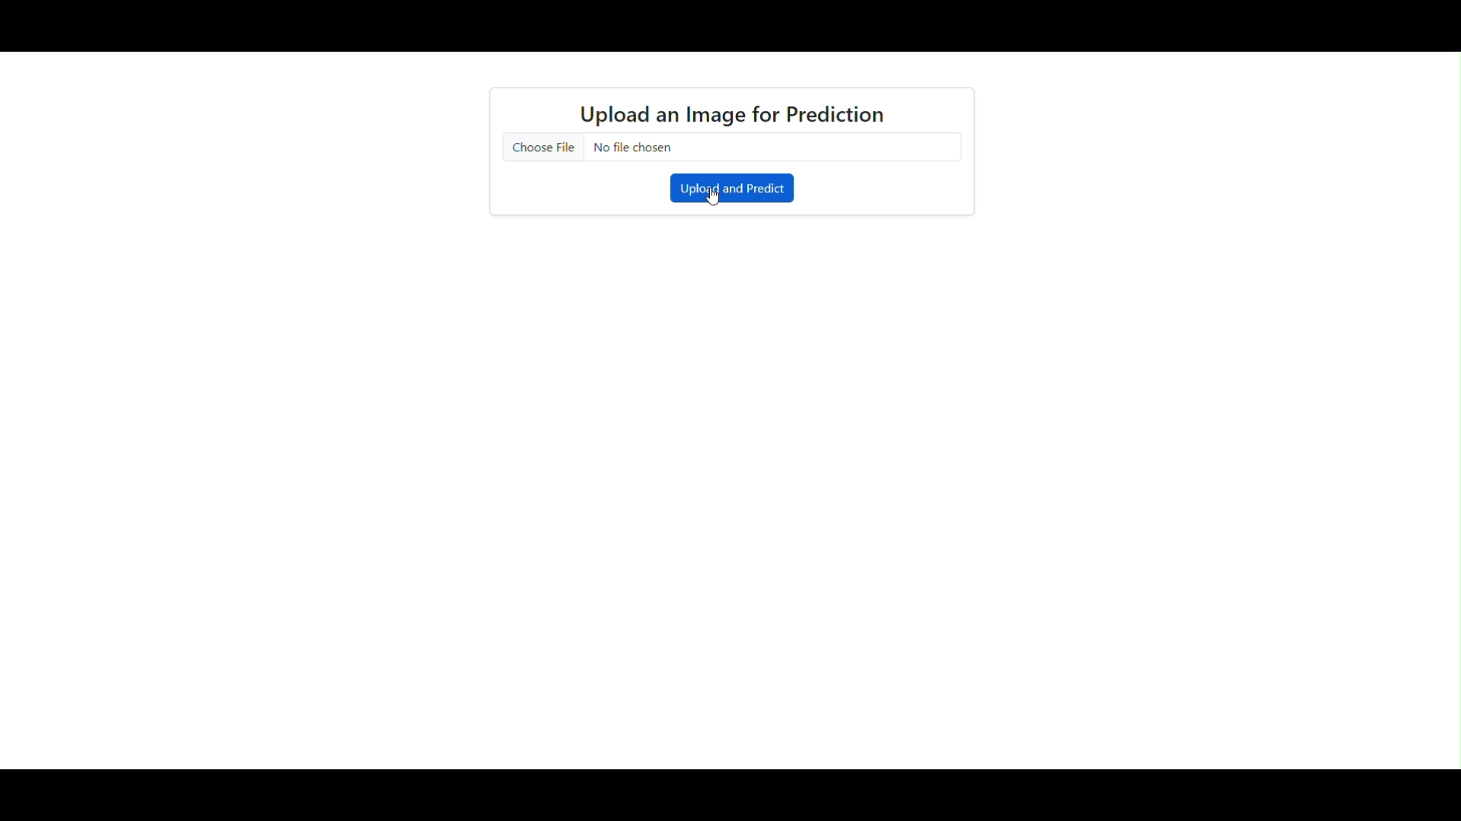

Slide 10
CHALLENGES & OBSTACLES
Transfer Learning didn‘t show any good results
In general it was hard to train the model and reaching a result of more than 80% was impossible
Training the models was extremely slow: Despite using a paid GPU through Google Colab it took a long time to run

Slide 11
CONCLUSION & INSIGHTS
The app deploying the model works well and can classify the images mostly, but it‘s hard to improve that any further
If trying out pictures from a non-existent category it will try to classify anyways
USE CASES FOR OUR PROJECT
With the same methodology we might as well create a model that can classify unknown organisms like plants and insects or to detect cancer

Slide 12
Deep Learning: Image Classification with CNN
THANK YOU FOR LISTENING!
DUSAN DOKIC, KEREM SENLER
& JULIA NUSS
PROJECT WEEK 6

